Slide 1
Peak Detection in Time Series
Presentation of Final Results
Nestor Weidemann, Nathira Wijemanne
Autonomous Multisensor Systems Group
Institute for Intelligent Cooperating Systems
Faculty of Computer Science
Otto von Guericke University Magdeburg
16.09.2025

Slide 2

Overview
Introduction
Methodology
Results
Comparison
Conclusion
Peak Detection in Time Series | N. Weidemann, N. Wijemanne

Slide 3
Introduction
Peak Detection in Time Series | N. Weidemann, N. Wijemanne

Slide 4

Introduction
Motivation
Sudden power surges can occur in the motor current of a milling machine
Important to distinguish between normal power increases (caused by the tool engaging with material) and abnormal peak anomalies
Consequences
Sharp peaks in current can stress the drive electronics, leading to a reduced motor lifespan
Increase in energy consumption
Peak Detection in Time Series | N. Weidemann, N. Wijemanne

Slide 5
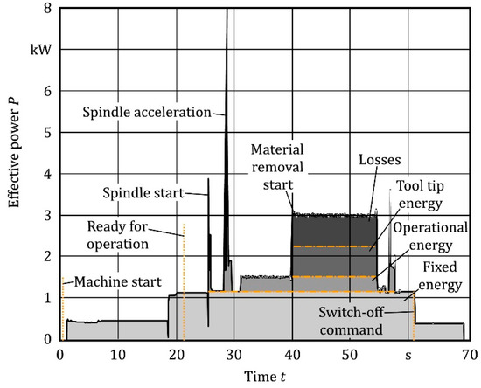
Introduction
Task
Implement and compare different approaches for peak detection
Use Case: Milling Machine
Goal
Identify sudden power surges
Detect anomalies or inefficiencies
Peak Detection in Time Series | N. Weidemann, N. Wijemanne
Notes:
The information can then be used to find errors in the G-Code

Slide 6
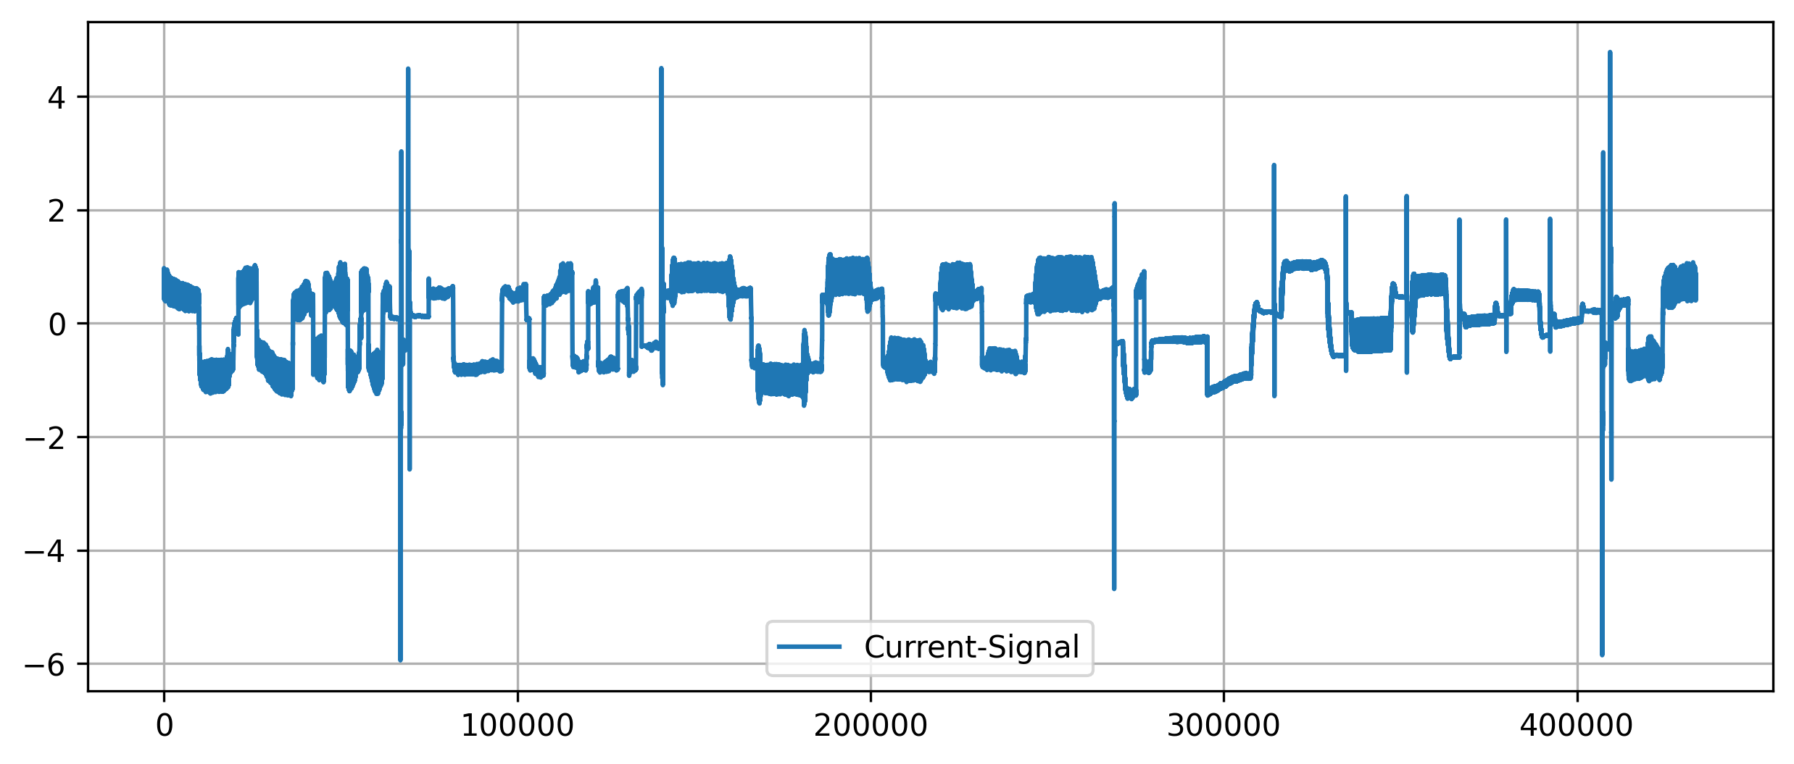
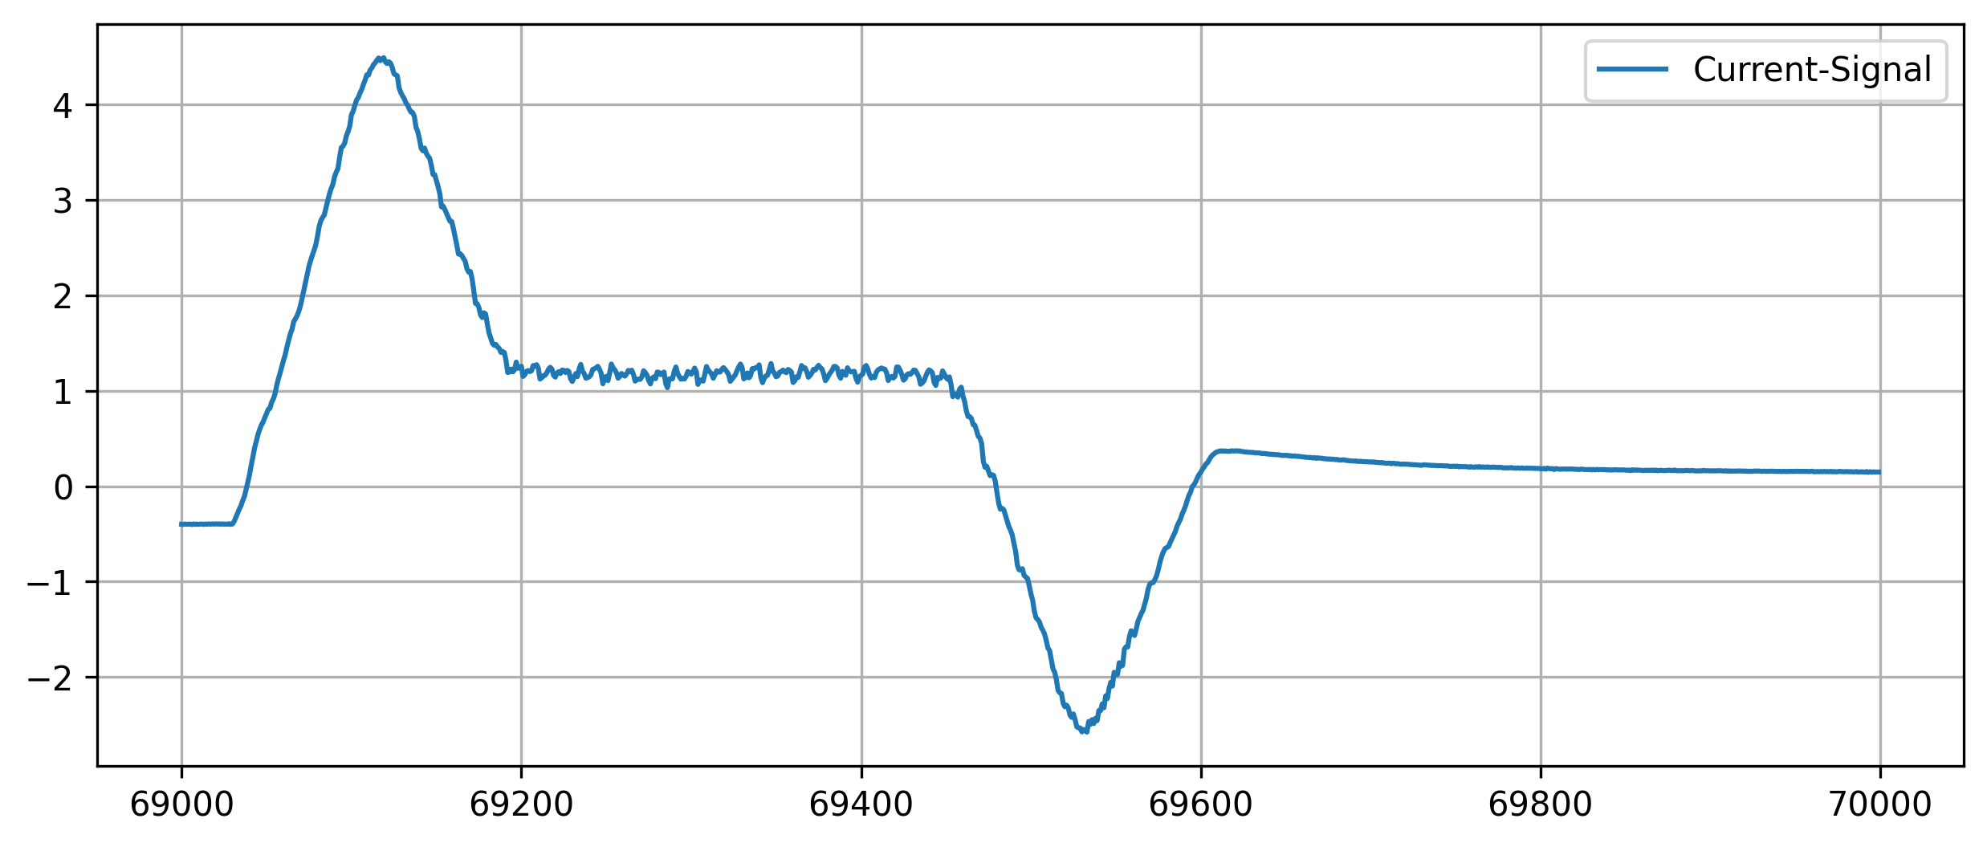
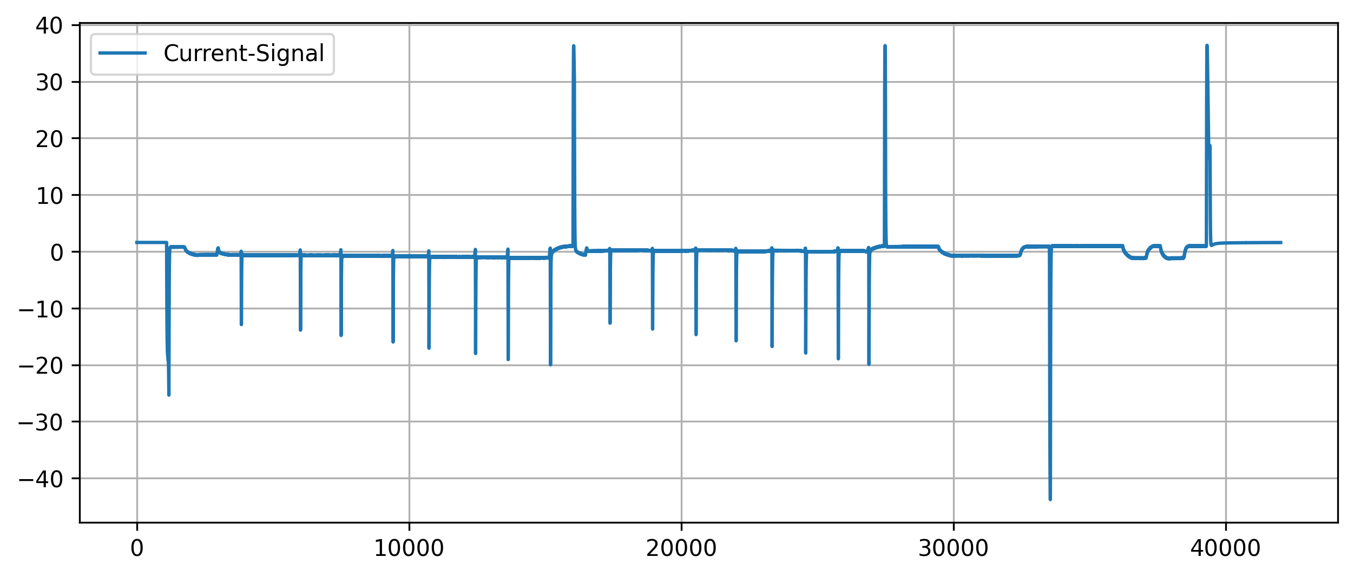
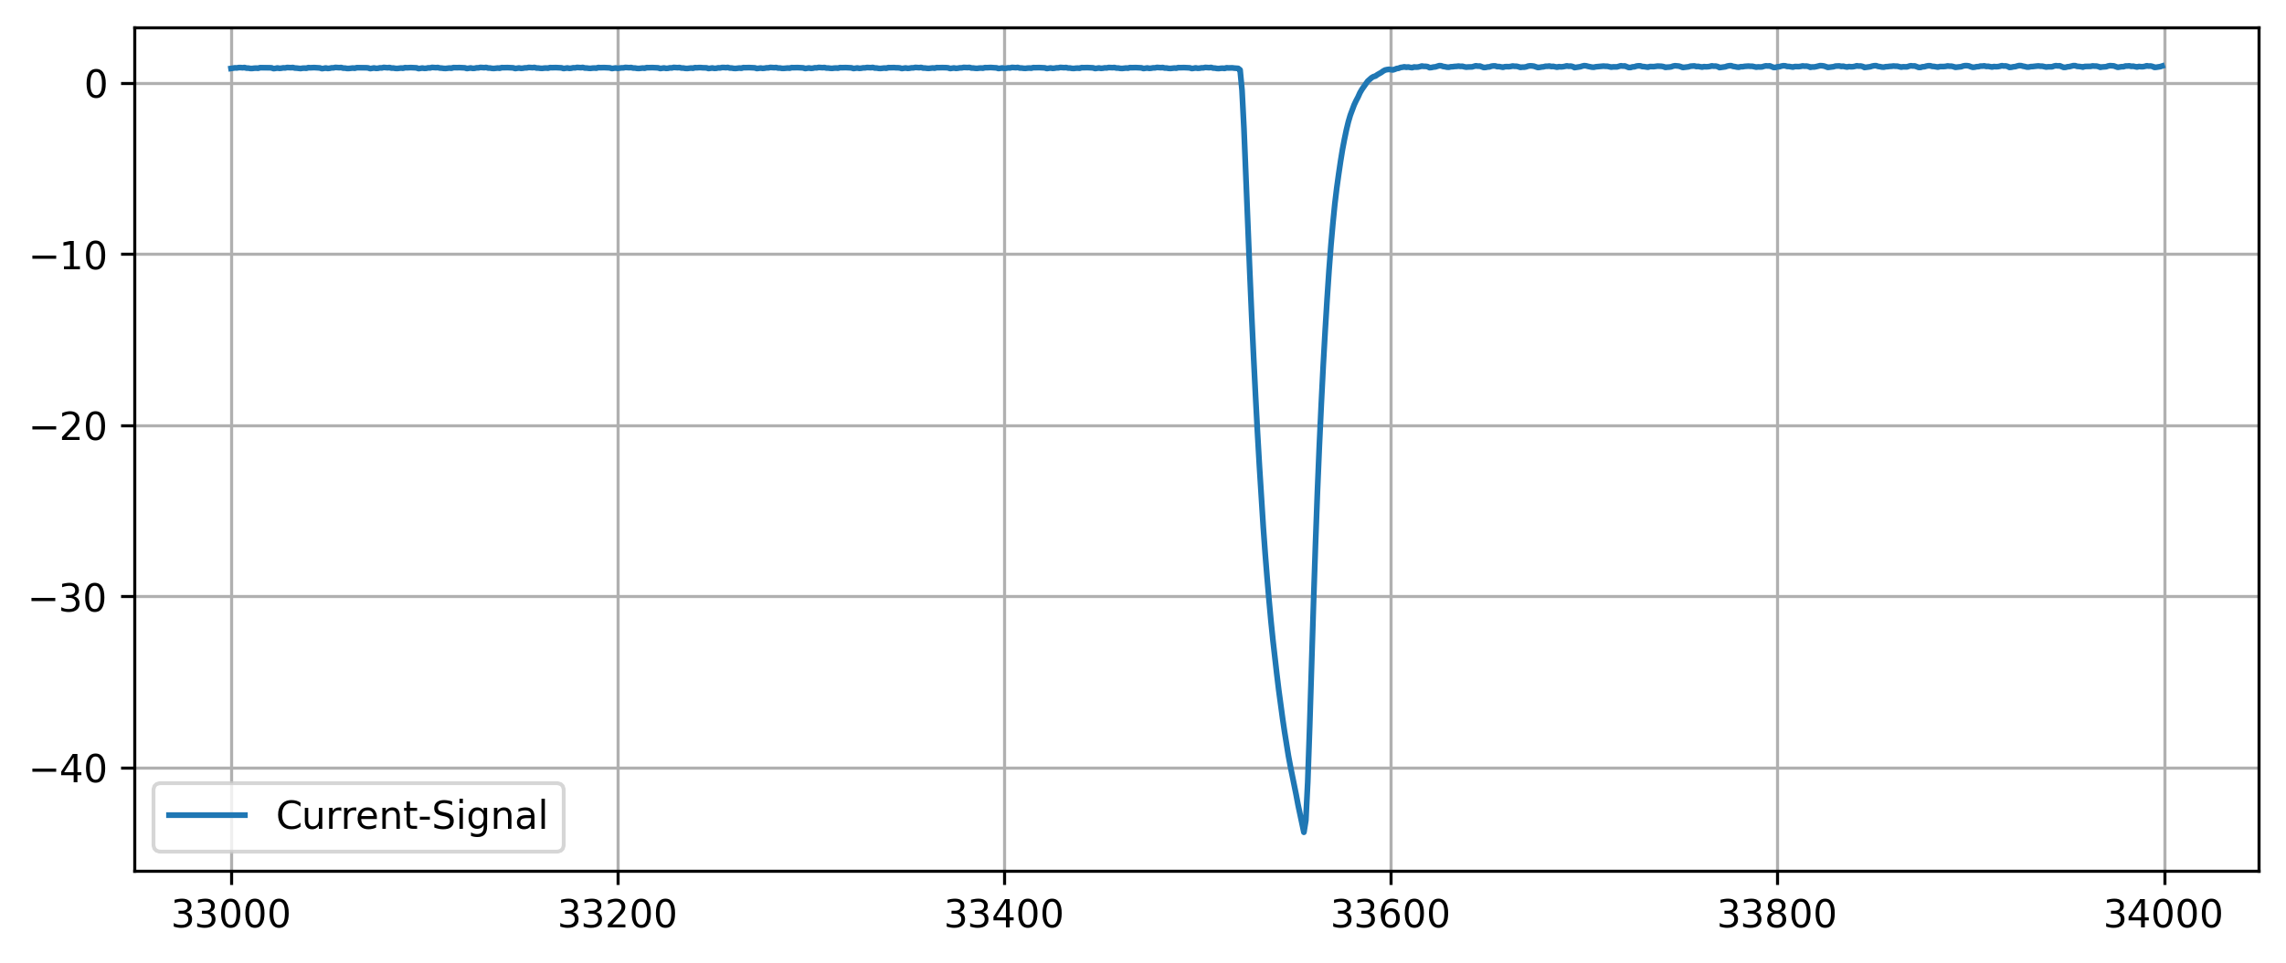
Introduction
Analysis of peak characteristics
Peak Detection in Time Series | N. Weidemann, N. Wijemanne
Notes:
Peaks can have different shapes and widths

Slide 7
Methodology
Peak Detection in Time Series | N. Weidemann, N. Wijemanne

Slide 8
Methodology
Univariate (and linear) approaches
Threshold-Based, Moving-Average, Wavelet Transform
Multivariate (and non-linear) approaches:
DBSCAN, K-Means, Autoencoder, Isolation Forest
Broad variety of techniques from simple to complex and data-driven
Peak Detection in Time Series | N. Weidemann, N. Wijemanne
Notes:
Linear methods assume a linear relationship or operate via linear operations
Nonlinear methods model complex, nonlinear relationships
Univariate methods analyze one time series at a time
Multivariate methods can consider multiple dimensions/features simultaneously

Slide 9
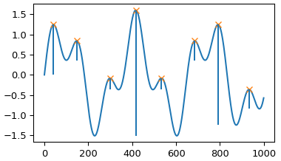
Methodology
Threshold-Based Approach
Preprocessing of input features
Torque: removing the DC-offset
Command-Speed: computing the absolute gradients
A peak is detected when:
The signal exceeds a certain threshold
The peak is prominent (significantly above its surroundings)
Peak Detection in Time Series | N. Weidemann, N. Wijemanne

Slide 10
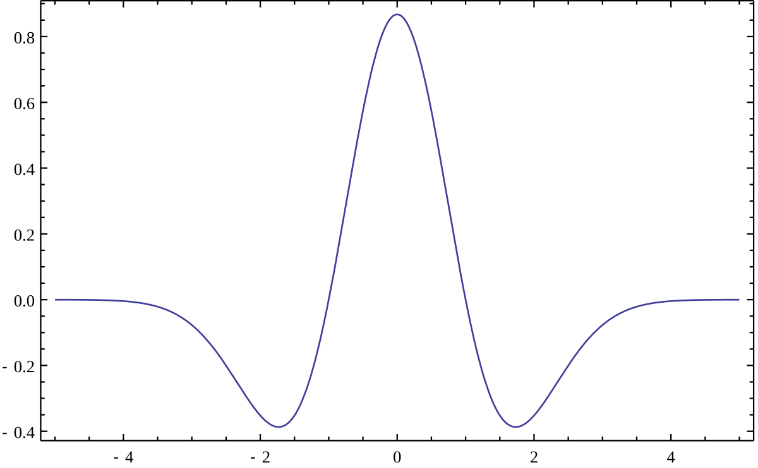
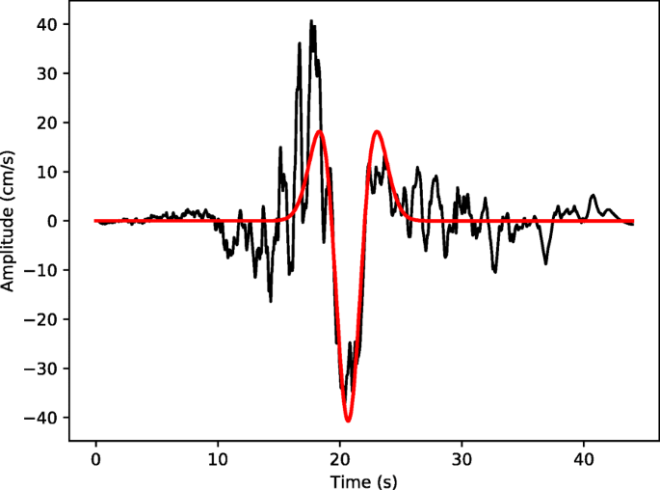
Methodology
Wavelet-Transform
Using the Ricker wavelet as a basis function
Decompose the signal into its components
Scale and shift the wavelet and apply convolution on the target signal
High response indicates strong similarity
Peaks appear as strong, aligned coefficients across multiple scales
Peak Detection in Time Series | N. Weidemann, N. Wijemanne
Notes:
Matrix: coefficients across different scales (frequencies) and positions (time)
Scipy uses a signal-to-noise ratio logic implicitly to judge peak strength

Slide 11
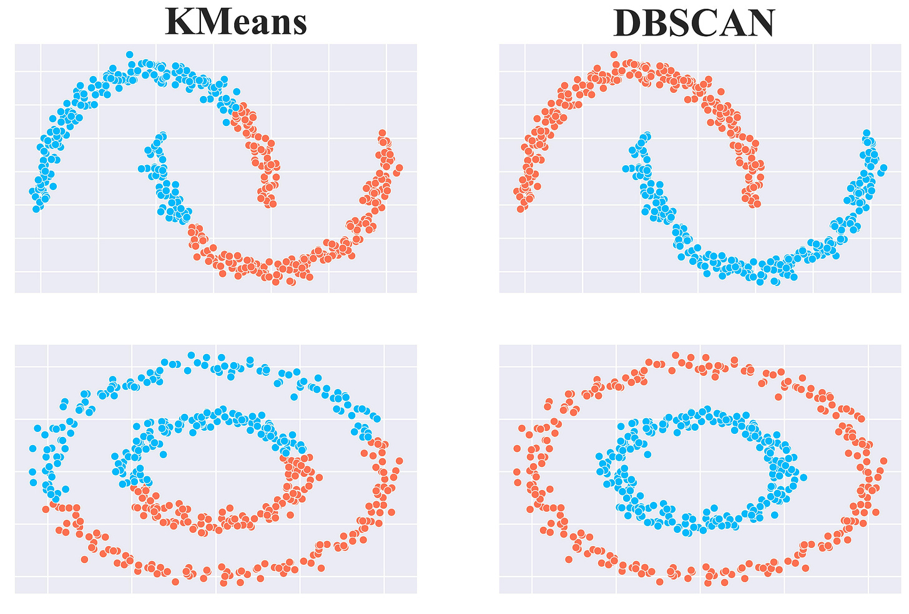
Methodology
Clustering with K-Means
Training an autoencoder to reproduce the input
The trained encoder-part is used to transform inputs into latent-space
Procedure:
Randomly initialize K centroids and assign each point to the nearest one
Recompute the centroids by calculating the mean of all points assigned to it
Repeat until changes in cluster assignments are minimal
Peak Detection in Time Series | N. Weidemann, N. Wijemanne
Notes:
Partitioning the data into k groups based on minimizing the distance between points and their assigned cluster centroids

Slide 12
Methodology
Clustering with DBSCAN
“Density-Based Spatial Clustering of Applications with Noise”
Training an autoencoder to reproduce the input
The trained encoder-part is used to transform inputs into latent-space
Grouping together points that are closely packed
Marking those as outliers that lie alone in low-density regions
Peak Detection in Time Series | N. Weidemann, N. Wijemanne
Notes:
Key parameter: epsilon controls the radius of neighborhood (distance threshold)

Slide 13
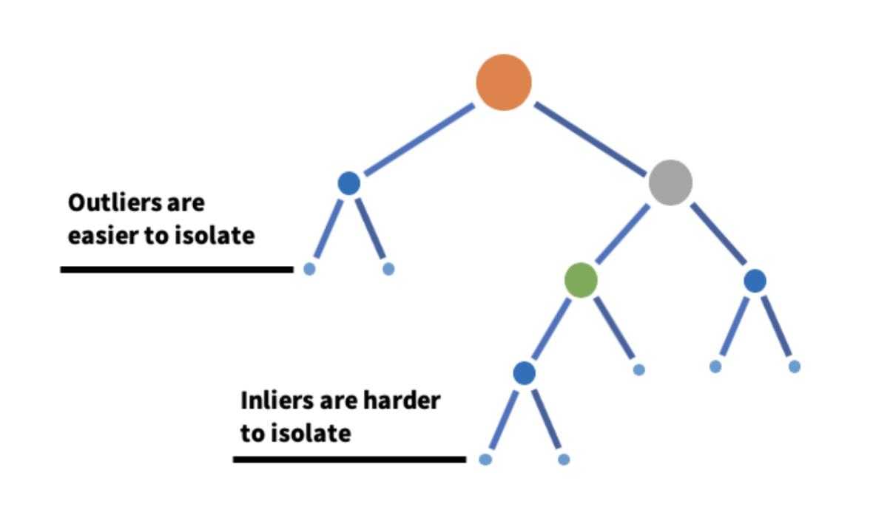
Methodology
Isolation Tree
Robust for detecting outliers and noise within the data, both positive and negative.
Does not assume the distribution of the data and useful for high dimensional datasets.
However, since it was not built for timeseries data, feature engineering was done to provide more temporal context.
Peak Detection in Time Series | N. Weidemann, N. Wijemanne
Notes:
Key parameter: contamination, number of trees
Uses Extremely Randomized Tree Regressors to separate anomalies from the rest of the data
Calculates an anomaly score for each data point and checks with a threshold. score depends on avg path length of an isolated point and average depth of all data points. closer to 1, strong anomaly
https://www.youtube.com/watch?v=kN--TRv1UDY

Slide 14
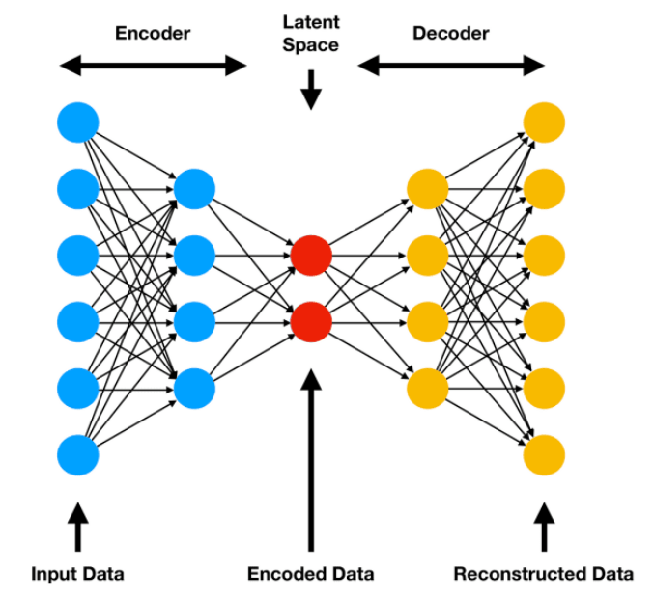
Methodology
Encoder-Decoder
Detects anomalies for multivariate timeseries data by learning non-linear patterns
LSTMs – designed for sequences
Peaks – deviations with high reconstruction error
However, high computational cost, requires a lot of hyperparameter tuning, and hard to interpret.
Peak Detection in Time Series | N. Weidemann, N. Wijemanne
Notes:
An autoencoder is a neural network model that seeks to learn a compressed representation of an input, known as the latent space. And the decoder tries to recreate the features based on the compressed representation. The goal is to minimize the difference between the original and reconstructed data.
Long Short-Term Memory, or LSTM, network are specifically designed to support sequences of input data.
If the reconstructed output is different from the original input, it can show an anomaly or outlier which makes autoencoders useful for fraud detection and system monitoring.
LSTM training is slower than CNNs
Hyperparameters: Number of layers/units, Sequence length, Learning rate, Dropout Batch size
Other parameters: reconstruction error threshold → IQR/percentile etc.

Slide 15
Methodology
Determining the parameters
Since no ground truth is available, the quality of the parameters is estimated purely from statistical metrics
Count of sequences without peaks (indicating missed detections)
Total number of peaks (indicating sensitivity)
Average peak height (indicating proportion of true-positives)
Average peak prominence (indicating significance of the peaks)
Using Pareto-Front-Analysis to select the best solution
Peak Detection in Time Series | N. Weidemann, N. Wijemanne
Notes:
Multi-Objective Optimization with Pareto-Front

Slide 16
Results
Peak Detection in Time Series | N. Weidemann, N. Wijemanne

Slide 17
Results – Threshold-Based Detection
Selected parameters
Torque as an input feature
Using 5 as a threshold and 1.1 as a minimum prominence
Optimal compromise between all metrics
Peak Detection in Time Series | N. Weidemann, N. Wijemanne

Slide 18
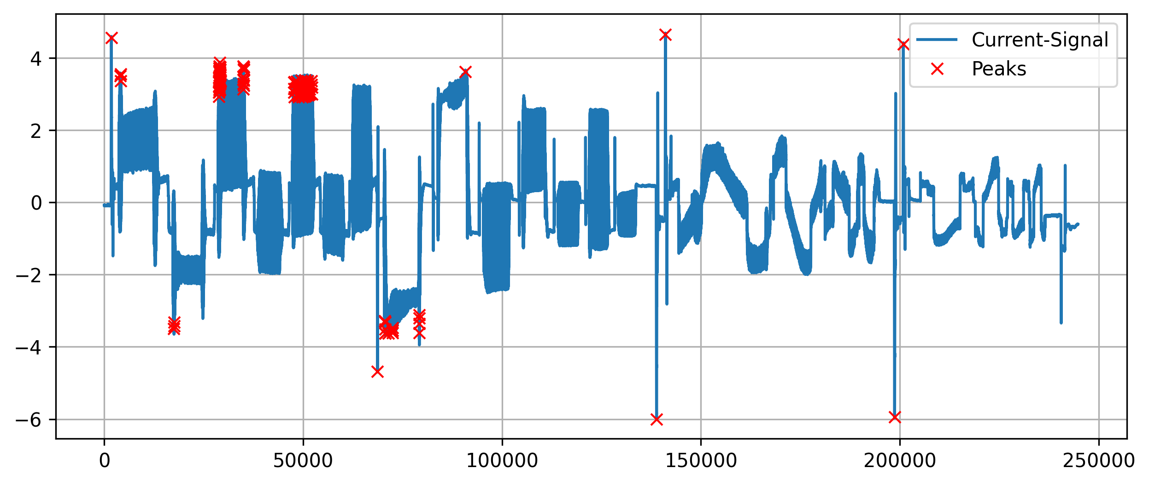
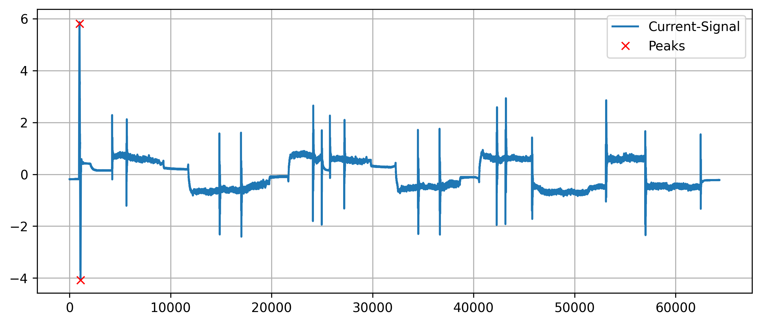
Results – Threshold-Based Detection
Analysis of the results
Good precision on easy examples with large outliers but fails on others with many false-positives (bad generalization)
Many of the true peaks were detected but not all
Characteristic of predicting one precise position and not an area
Can detect positive and negative peaks
Good alignment of the predicted position and the extremes
Peak Detection in Time Series | N. Weidemann, N. Wijemanne
Notes:
Seq0 ax1
Seq4 ax1

Slide 19
Results – Threshold-Based Detection
Selected parameters
Commanded speed as an input feature
Using 0.7 as a threshold and 1.1 as a minimum prominence
Optimal compromise between all metrics
Peak Detection in Time Series | N. Weidemann, N. Wijemanne

Slide 20
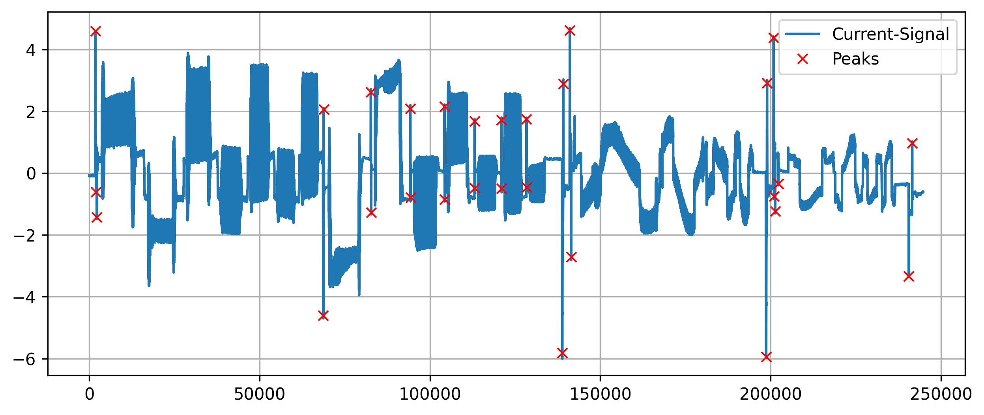

Results – Threshold-Based Detection
Analysis of the results
Very high precision (no false-positives)
Most of the true peaks were detected but not all (especially peaks with a smaller amplitude)
Characteristic of predicting one precise position and not an area
Can detect positive and negative peaks
Not a perfect alignment of the predicted position and the extremes
Peak Detection in Time Series | N. Weidemann, N. Wijemanne
Notes:
Seq0 ax1
Seq4 ax1

Slide 21
Results – Wavelet Transform
Selected parameters
Torque as an input feature
Using the Ricker-Wavelet with widths between 100 and 150
Best tradeoff between amplitude and prominence with a more realistic peak count
Peak Detection in Time Series | N. Weidemann, N. Wijemanne

Slide 22
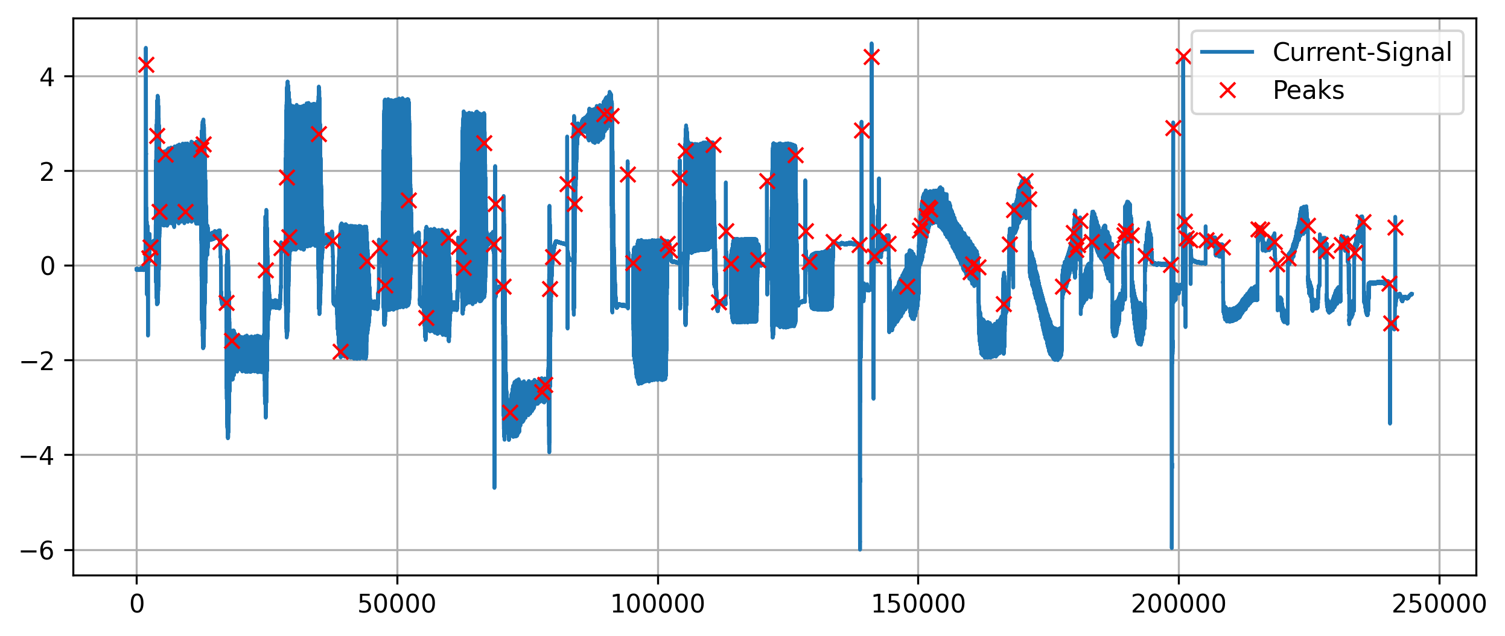
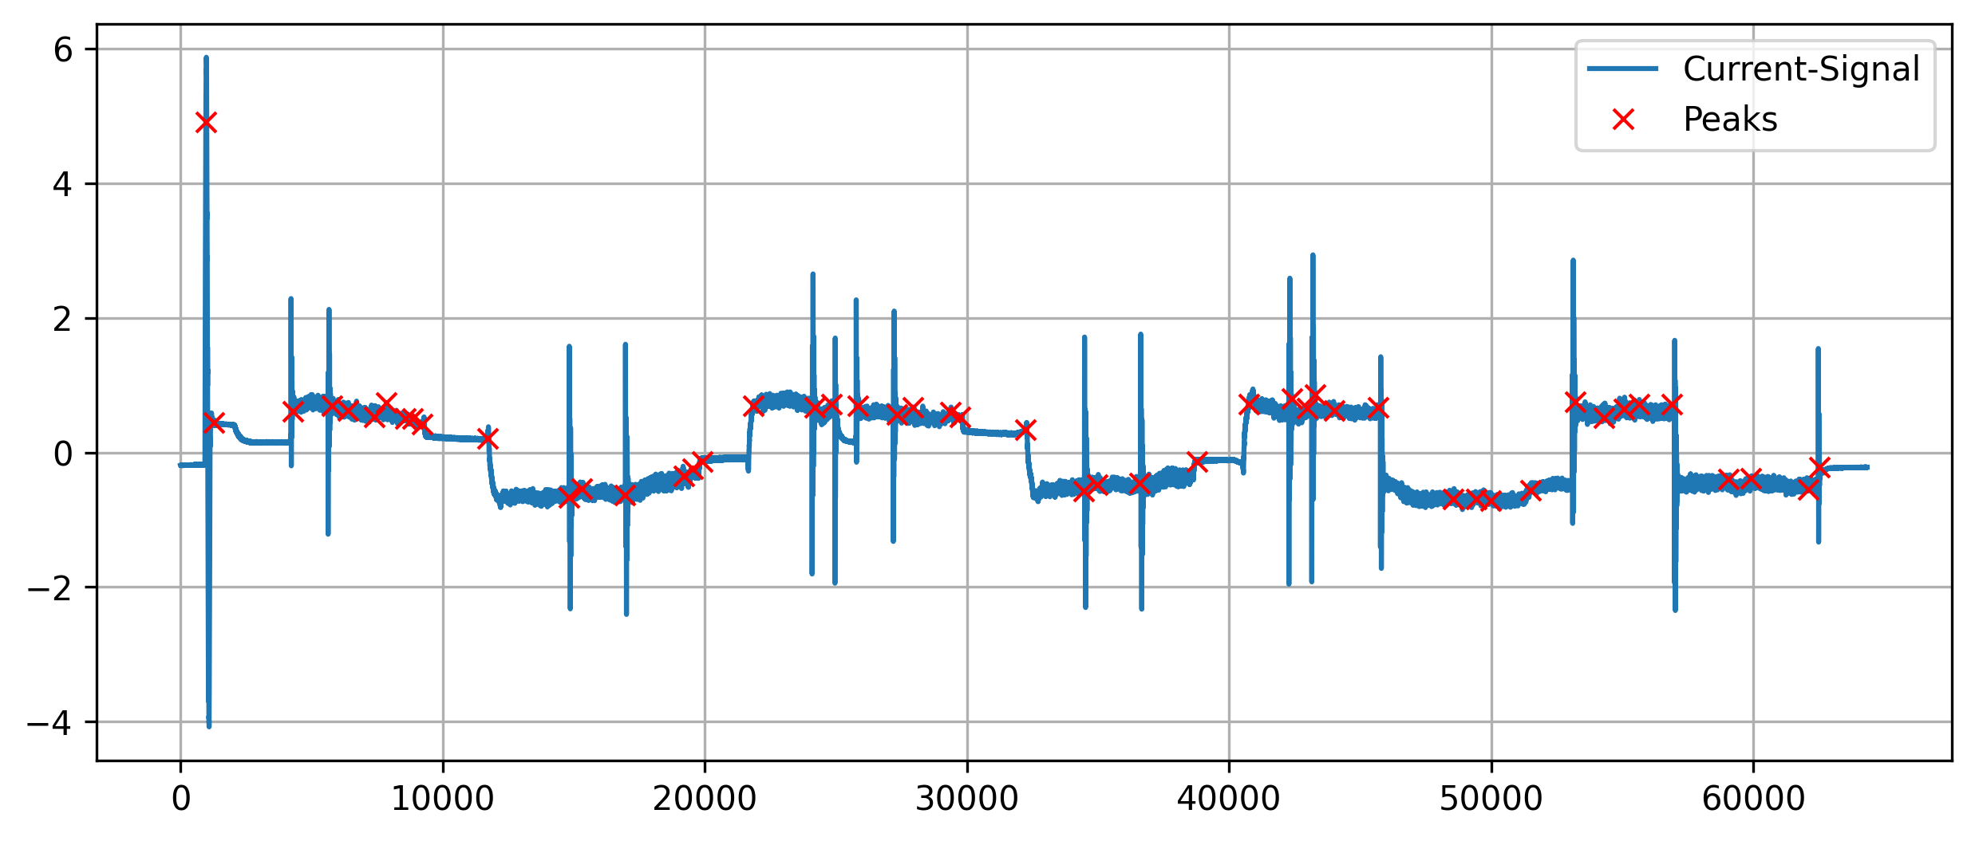
Results – Wavelet Transform
Analysis of the results
Very bad precision (many false-positives)
Most of the true peaks were detected but not all
Characteristic of predicting one precise position and not an area
Can detect only positive peaks (with one single wavelet)
Peak Detection in Time Series | N. Weidemann, N. Wijemanne
Notes:
Seq0 ax1
Seq4 ax1

Slide 23
Results – Wavelet Transform
Possible reason of failure
Peaks have different shapes and widths
Shape of peaks are indistinguishable from noise
Examples pictures …
Peak Detection in Time Series | N. Weidemann, N. Wijemanne

Slide 24
Results – Clustering with DBSCAN
Selected parameters
Torque as an input feature and epsilon = 3.5
Highest mean prominence, no sequences without peaks and decent mean amplitude
Peak Detection in Time Series | N. Weidemann, N. Wijemanne

Slide 25
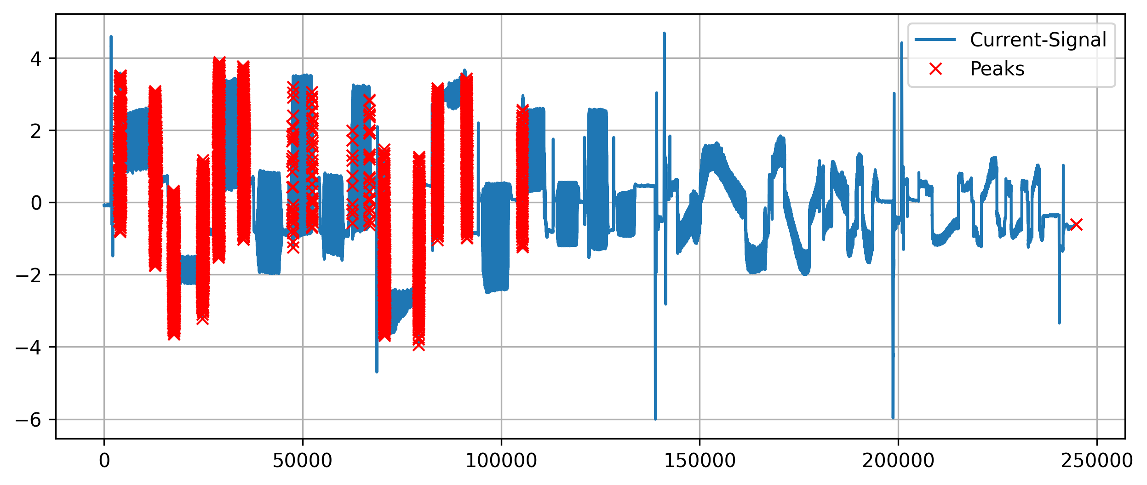
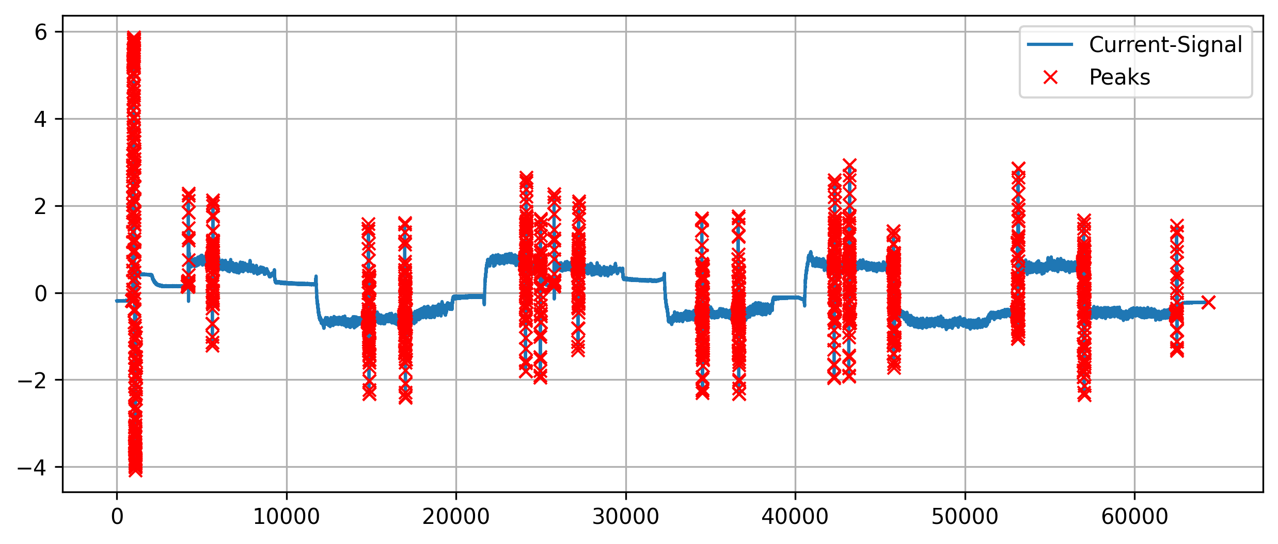
Results – Clustering with DBSCAN
Analysis of the results
Very high precision (almost no false-positives)
Some peaks were not detected
Characteristic of marking the whole peak area instead of just one precise position
Can detect positive and negative peaks
Peak Detection in Time Series | N. Weidemann, N. Wijemanne
Notes:
Seq0 ax1
Seq4 ax1

Slide 26
Results – Clustering with K-Means
Selected parameters
Using 2 clusters (binary classification)
Commanded speed as an input feature
Higher mean prominence and amplitude and more realistic peak count
Peak Detection in Time Series | N. Weidemann, N. Wijemanne

Slide 27
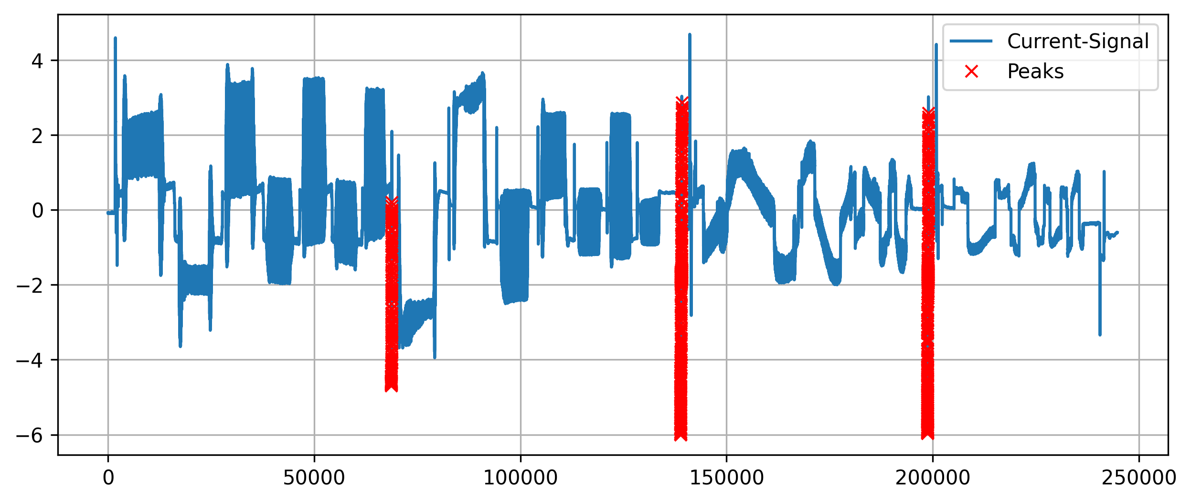
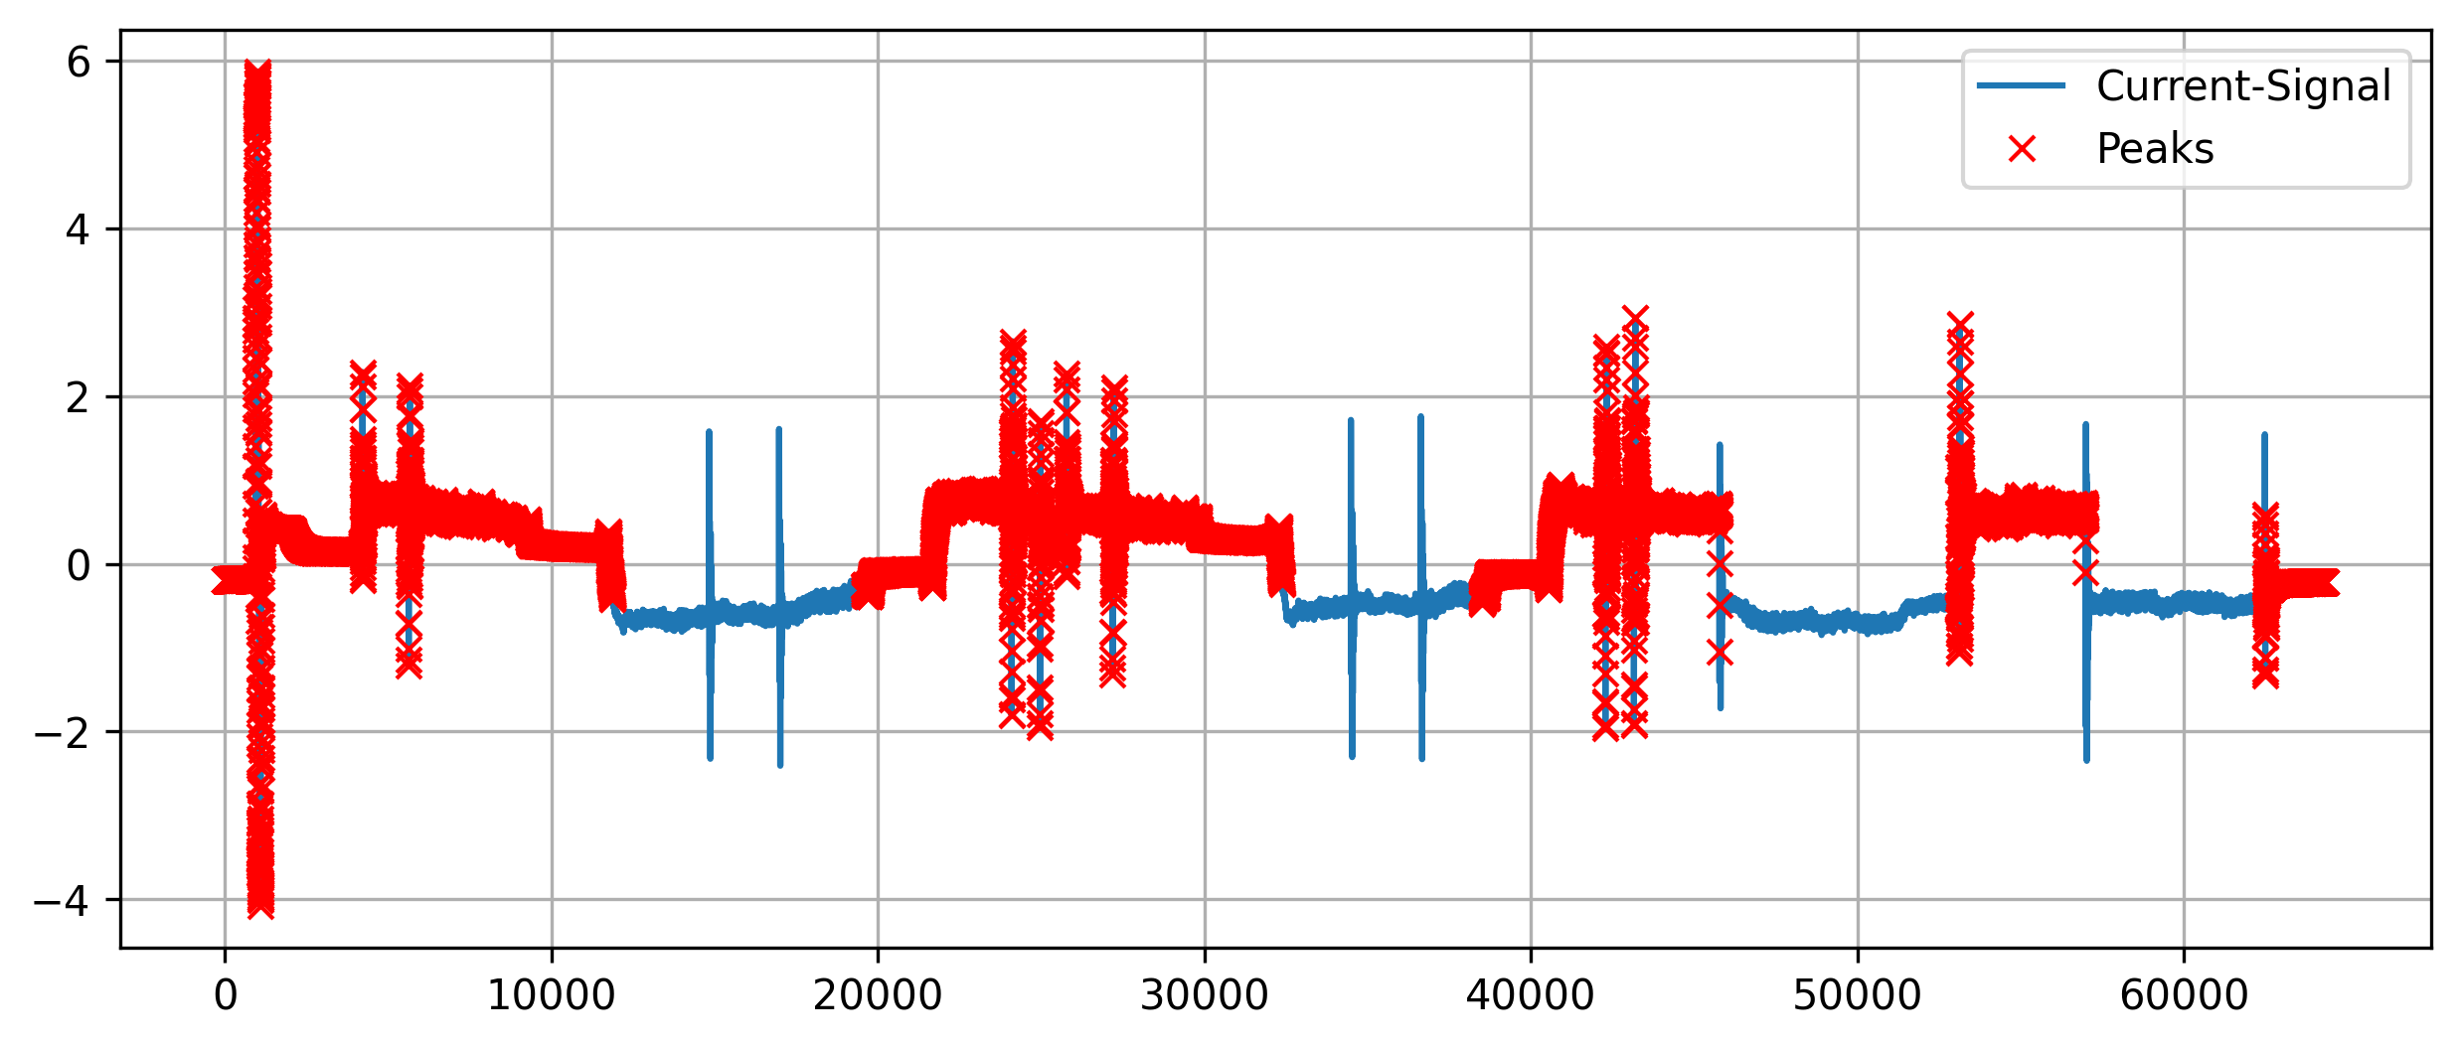
Results – Clustering with K-Means
Analysis of the results
False-positives issues on some sequences
Many peaks were not detected
Recognizable tendency of detecting peaks
Characteristic of marking the whole peak area instead of just one precise position
Can detect positive and negative peaks
Peak Detection in Time Series | N. Weidemann, N. Wijemanne
Notes:
Seq0 ax1
Seq4 ax1

Slide 28
Results – Isolation Tree
Selected parameters
Features: Torque, Moving Average of Torque as input
Parameters:
Contamination: 0.01
Number of estimators: 100
Higher median F1 score (against pseudo labels ) and more realistic peak count
However, better results for certain sequences → Not very generalizable
Peak Detection in Time Series | N. Weidemann, N. Wijemanne

Slide 29
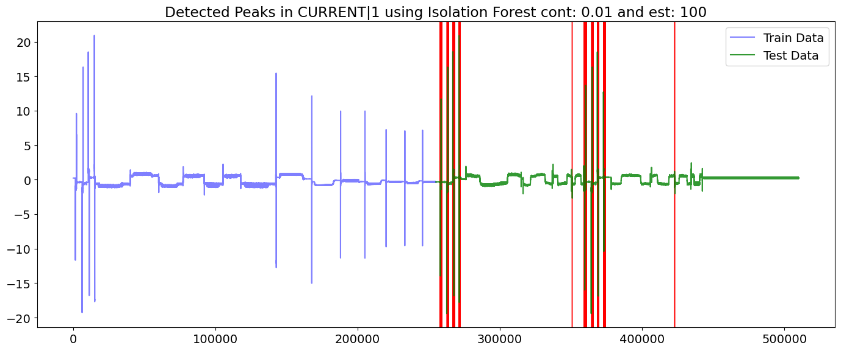
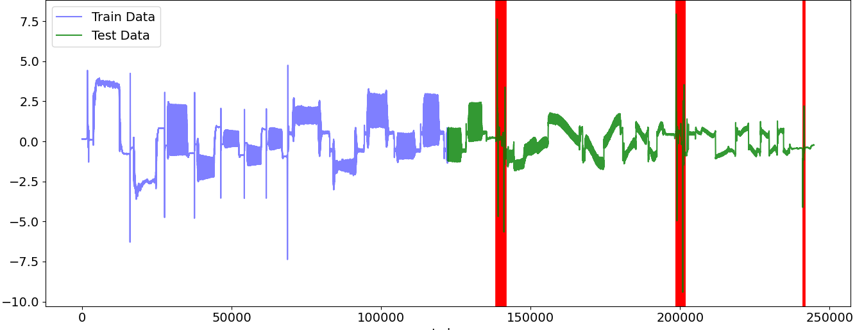
Results – Isolation tree
Analysis of the results
Not many false-positives issued on the sequences
Many peaks were not detected
Characteristic of marking the whole peak area instead of just one precise position
Can detect positive and negative peaks
Peak Detection in Time Series | N. Weidemann, N. Wijemanne
Notes:
Seq0 ax1
Seq4 ax1

Slide 30
Results – Autoencoder
Selected parameters
Features: Torque as input
Parameters:
Contamination: 0.01
Latent dims: 8
Epochs: 50
Batch size: 64
Peaks were not detected at all in some sequences
However, good results for certain sequences → Not very generalizable
Peak Detection in Time Series | N. Weidemann, N. Wijemanne

Slide 31
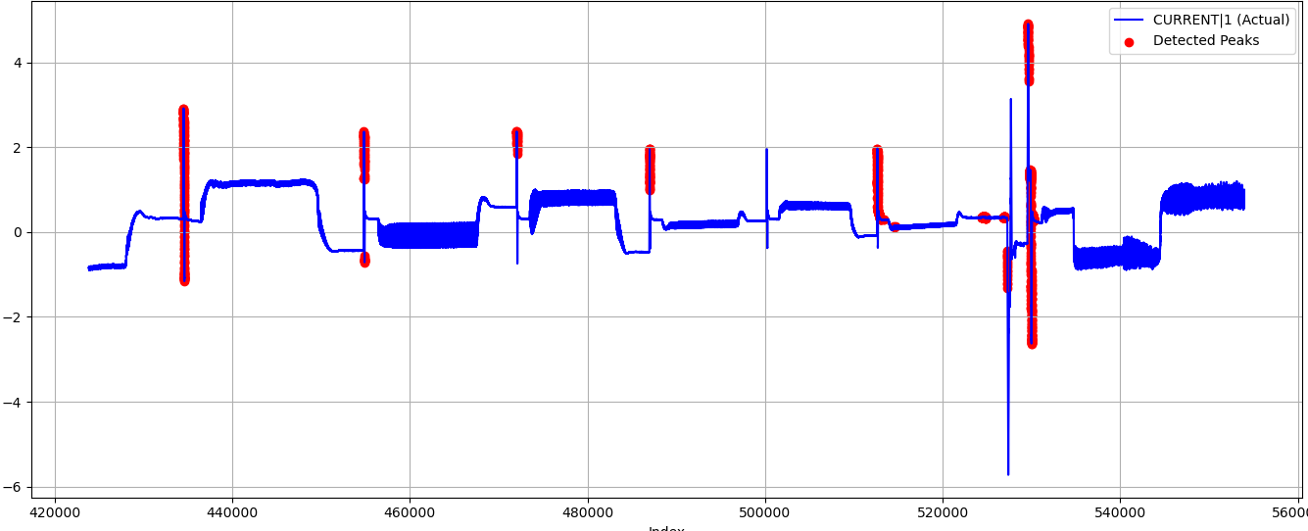
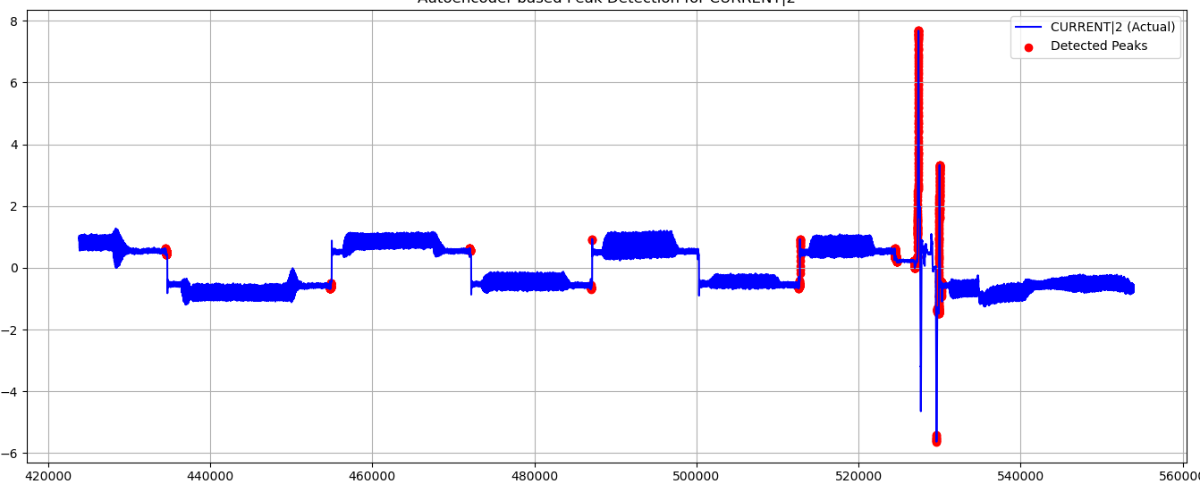
Results – Autoencoder
Analysis of the results
Not many false-positives issued on the sequences
Many peaks were not detected
Can detect positive and negative peaks
Detects smaller deviations but sometimes unable to identify larger deviations → not good
Peak Detection in Time Series | N. Weidemann, N. Wijemanne

Slide 32
Comparison
Peak Detection in Time Series | N. Weidemann, N. Wijemanne

Slide 33
Comparison
Linear vs non-linear
Interpretability vs model complexity
Real-world applications
Computational costs / speed
Precision
Recall
Robustness and Generalization
Peak Detection in Time Series | N. Weidemann, N. Wijemanne

Slide 34
Comparison
Methods ordered by computational costs / speed (from fastest to slowest):
Threshold-based methods
Isolation Tree
Clustering with K-Means
Clustering with DBSCAN
Wavelet-Transform
LSTM Auto-encoder
Peak Detection in Time Series | N. Weidemann, N. Wijemanne

Slide 35
Comparison
Methods ordered by precision (from accurate to inaccurate):
Threshold-based detection (with commanded speed as input)
Clustering with DBSCAN
Threshold-based detection (with torque as input)
Clustering with K-Means
Wavelet-Transform
Peak Detection in Time Series | N. Weidemann, N. Wijemanne

Slide 36
Comparison
Methods ordered by recall (from accurate to inaccurate):
Wavelet-Transform
Threshold-based detection (with commanded speed as input)
Clustering with DBSCAN
Threshold-based detection (with torque as input)
Clustering with K-Means
Peak Detection in Time Series | N. Weidemann, N. Wijemanne

Slide 37
Conclusion
Peak Detection in Time Series | N. Weidemann, N. Wijemanne

Slide 38
Conclusion
Asd
Asd
Peak Detection in Time Series | N. Weidemann, N. Wijemanne

Slide 39
Conclusion
Ideas for improvement
Rescale the signals by a material-specific factor to align dynamics in the current caused by normal workload within the same zone to improve generalization
Consider both the width of each peak and its proximity to neighboring peaks
Apply smoothing to the signal to filter noise and remove unsignificant peaks
Coalescence (cluster formation): peaks that are close to each other (within a window distance k) are combined so that only the highest peak remains
Peak Detection in Time Series | N. Weidemann, N. Wijemanne

Slide 40
Conclusion
Findings
Anomalies are likely caused by sudden changes in the commanded speed (speed setpoint from the trajectory planner to the motor controller)
Sharp edges in the speed setpoint seem to cause the peaks in the current
There seems to be a bug within the planning unit
Spindle signal looks like a discrete signal with hard edges (instead of smooth, continuous transitions
Peak Detection in Time Series | N. Weidemann, N. Wijemanne

Slide 41
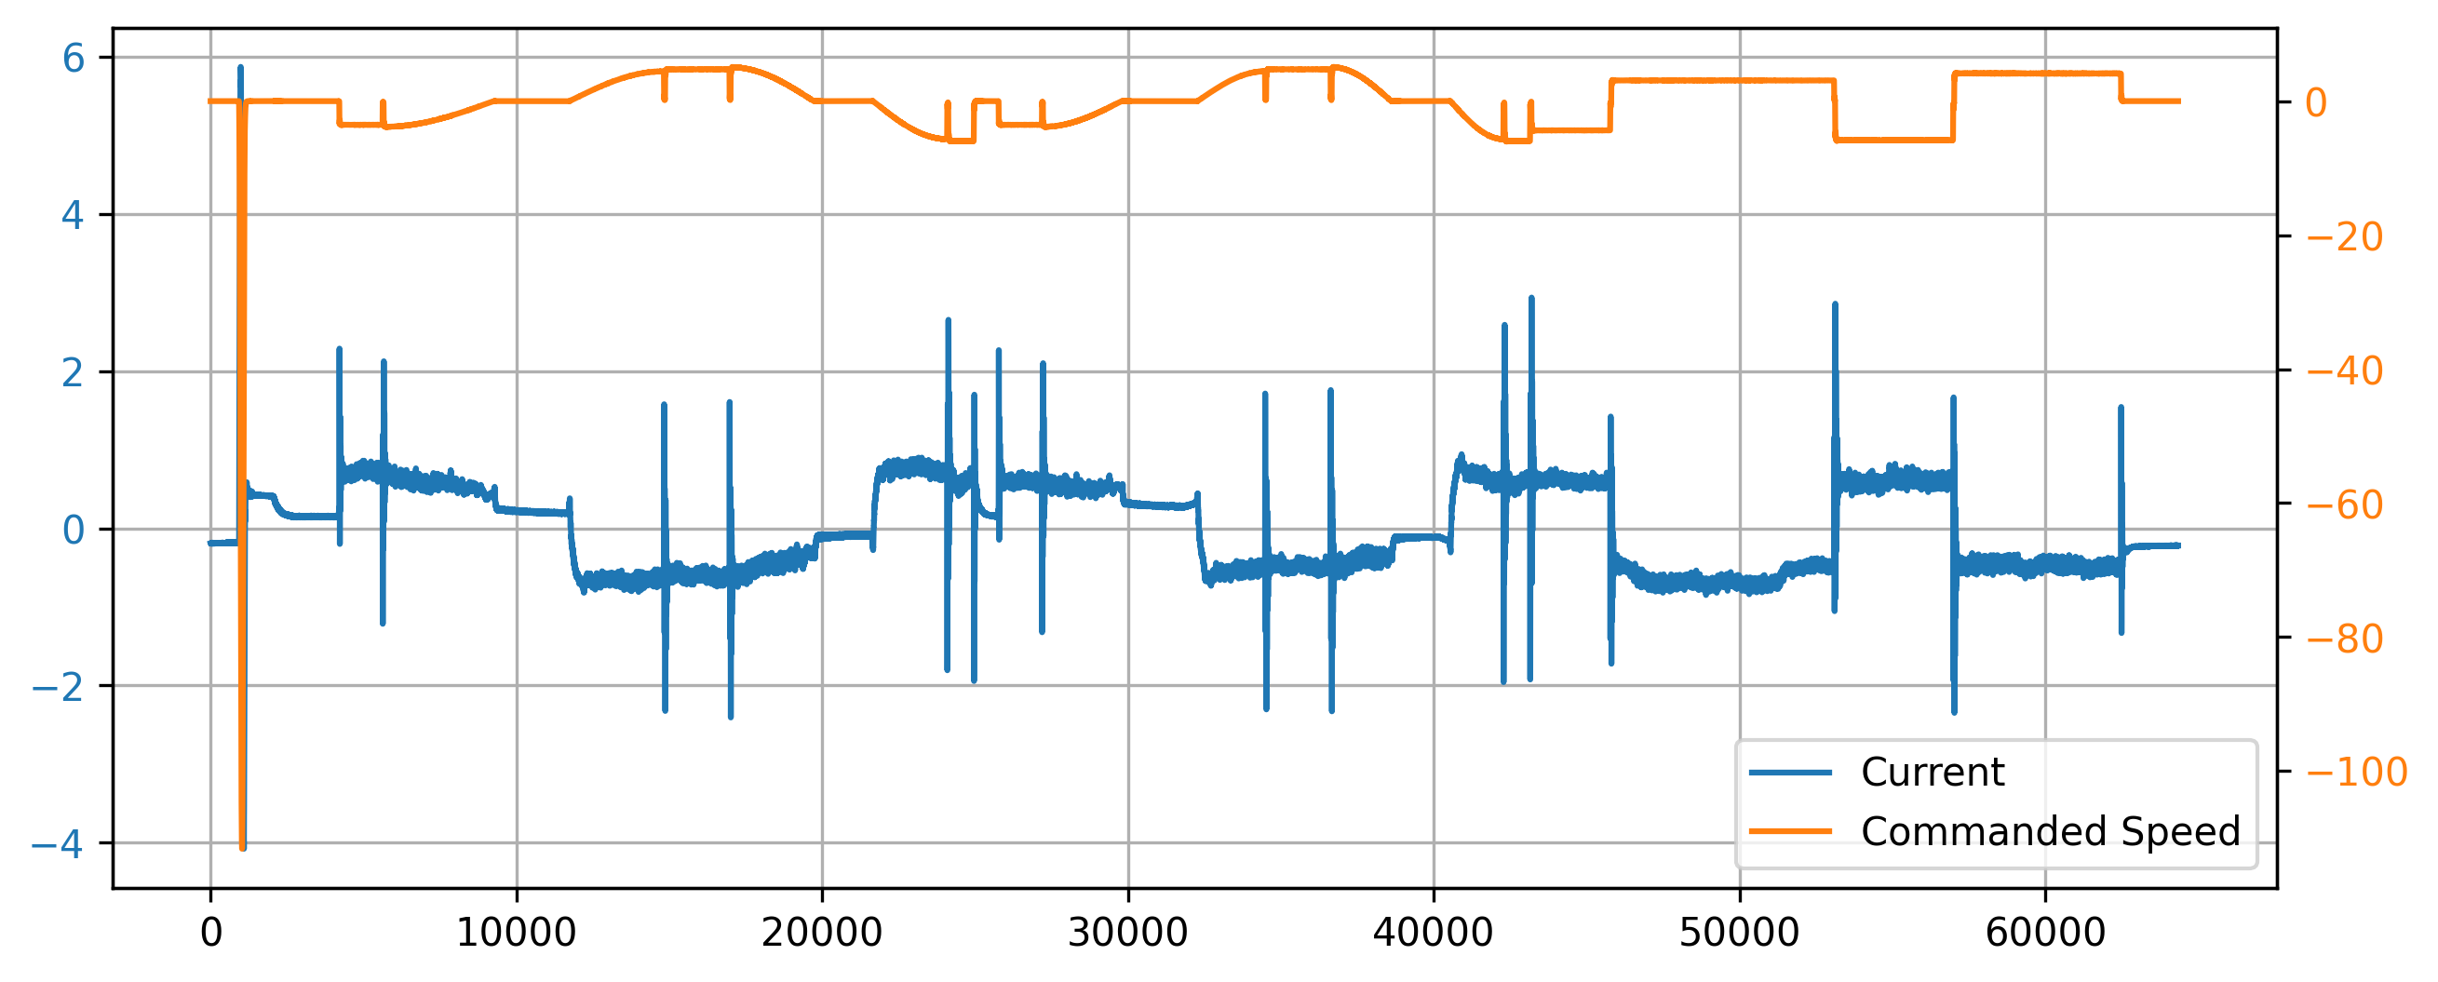
Conclusion
3 different types of anomalies
Large outlier
Flickering of the signal to zero
Jumping between quantized levels
1.
2.
3.
Peak Detection in Time Series | N. Weidemann, N. Wijemanne

Slide 42
Peak Detection in Time Series
Intermediate Progress and Results Update
Thank You For Your Attention!
Nestor Weidemann
Mail: nestor.weidemann@st.ovgu.de
Nathira Wijemanne
Mail: nathira.wijemanne@st.ovgu.de

Slide 43
References for Graphics
[1] https://www.fptindustrie.com/deu/
[2] https://www.mdpi.com/1996-1073/17/15/3659
[3] https://en.wikipedia.org/wiki/Ricker_wavelet
[4] https://link.springer.com/article/10.1007/s10950-019-09845-y
[5] https://docs.scipy.org/doc/scipy/reference/generated/scipy.signal.peak_prominences.html
[6] https://blog.dailydoseofds.com/p/the-limitations-of-dbscan-clustering
[7]
Peak Detection in Time Series | N. Weidemann, N. Wijemanne
Notes:
Clustering method -> Hyper parameter tuning
Autoencoder ->
Pseudo labels for evaluation for each approach
Considering efficiency and computational cost when evaluating

Slide 44
Backup
Peak Detection in Time Series | N. Weidemann, N. Wijemanne

Slide 45
Dataset
Number of Rows: ~1.6 Million
Time Series data across:
2 Machine Types (CMX1, DMC2)
2 Materials (AL, S)
2 Components (CP1, CP2)
-> 8 different measurements
Variables measured across 4 axes: X (1), Y (2), Z (3) and Spindle (6)
Target Variable: Current
Possible Input Variables: Load, Motor shaft positions (actual & desired), Control deviation, Torque, Feedforward velocity, Feedforward torque, Commanded Speed, and etc.
Peak Detection in Time Series | N. Weidemann, N. Wijemanne

Slide 46
Dataset
Relationships:
For all axes: Current ∝ Torque
For all Z: Current ∝ Load (>0.9 correlation)
Machine CMX1, Spindle: Current ∝ Load (>0.9 correlation)
Machine DMC2, Y & Z: Current ∝ Encoder Positions (>0.9 correlation)
Component 2, Y: Current ∝ Load (>0.9 correlation)
Component 1, Spindle: Current ∝ Load (~0.7 correlation)
Peak Detection in Time Series | N. Weidemann, N. Wijemanne

Slide 47
Intermediate Results
Sensitivity analysis was done for each technique to identify model that is best suited
Pseudo labels were used for metric calculation and evaluation
Metrics used:
F1 Score (using Pseudo labels)
Count of sequences with no peaks
Total number of peaks
Average peak height
Average peak prominence
Peak Detection in Time Series | N. Weidemann, N. Wijemanne
Notes:
· The prominence of a peak measures how much the peak stands out due to its intrinsic height and its location relative to other peaks. It's not just how high the peak is, but how independent it is from nearby peaks.

Slide 48

Explanation of the approaches
Isolation Forest
Uses Extremely Randomized Tree Regressors to separate anomalies from the rest of the data
Peak Detection in Time Series | N. Weidemann, N. Wijemanne
Notes:
Calculates an anomaly score for each data point and checks with a threshold. score is depends on avg path length of an isolated point and average depth of all data points. closer to 1, strong anomaly https://www.youtube.com/watch?v=kN--TRv1UDY

Slide 49
Explanation of the approaches
Autoencoder Model
Peak Detection in Time Series | N. Weidemann, N. Wijemanne
Notes:
Encoder: The encoder takes the input data (e.g., an image, a sound clip, or a text document) and compresses it into a lower-dimensional representation, known as the latent space or encoded representation.
Decoder: The decoder takes the compressed representation and tries to reconstruct the original input. The goal is to minimize the difference between the original and reconstructed data.
If the reconstructed output is different from the original input, it can show an anomaly or outlier which makes autoencoders useful for fraud detection and system monitoring.
https://towardsdatascience.com/auto-encoder-what-is-it-and-what-is-it-used-for-part-1-3e5c6f017726/

